Slide 1
ERHS 561
Emergency Response
Alexander Brandl
Environmental and Radiological Health Sciences

Slide 2
Emergency
IAEA definition
non-routine situation or event
necessitates prompt action
to mitigate a hazard or adverse consequences
for human health and safety, quality of life, property, or the environment
nuclear and radiological
includes mitigation of effects of a perceived hazard

Slide 3
Preparedness / Response
Emergency preparedness
capability to take actions
will effectively mitigate the consequences of an emergency
Emergency response
performance of actions
mitigate the consequences of an emergency
basis for resumption of normal social and economic activity
Emergency plan
objectives, policy, and concept of operations for emergency response
structure, authorities, and responsibilities for a systematic, coordinated, and effective response

Slide 4
Preparedness Goals
Emergency preparedness
helps to build confidence that emergency response
managed
controlled
coordinated effectively
Goals
ensure arrangements are in place
response to be timely, managed, controlled, coordinated, and effective
local, regional, national, and international

Slide 5
Response Goals
Goals
regain control of the situation
prevent or mitigate consequences at the scene
prevent deterministic health effects
first aid and treatment of radiation injuries
prevent, to the extent practicable, stochastic health effects in the population
prevent, to the extent practicable, non-radiological effects on individuals or in the population
protect, to the extent practicable, property and environment
prepare, to the extent practicable, resumption of normal social and economic activity

Slide 6
Organizations
National coordinating authority
responsibility for coordination
nuclear or radiological and conventional response
Response organizations
implementation of coordinated arrangements
Regulatory body
oversight for implementation of coordinated arrangements at the operator

Slide 7
Timely Response
Emergency situation
time is short
decision making
implementing an effective strategy for response
management system
pre-arranged
tested
compatible

Slide 8
Threat Assessment
Safety analysis
identify all sources of exposure
evaluate radiation doses that could be received by workers and the public
potential effects on the environment
examine event sequences that could lead to emergencies
basis for emergency preparedness and response

Slide 9
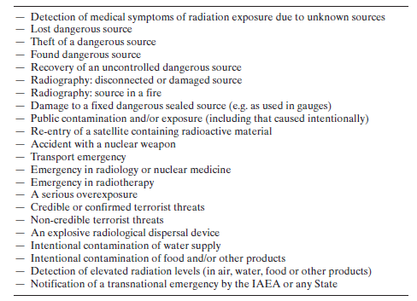
Emergency Scenarios
Types of event associated with radiological emergencies

Slide 10
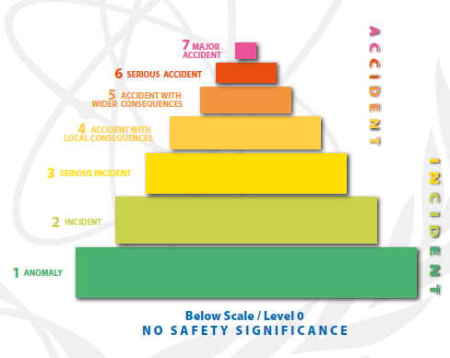
Emergency Classification
International Nuclear and Radiological Event Scale (INES)
tool for communication to the public

Slide 11
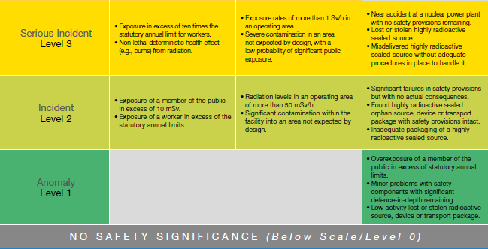
INES
Levels 0 - 3

Slide 12
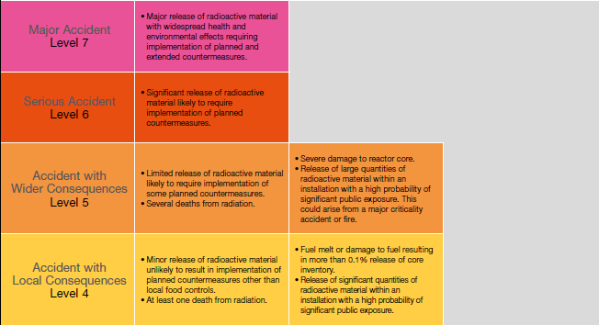
INES (II)
Levels 4 - 7

Slide 13
Incidents
Examples at nuclear facilities

Slide 14
Accidents
Examples at nuclear facilities

Slide 15
Incidents (II)
Examples with radiological sources

Slide 16
Accidents (II)
Examples with radiological sources

Slide 17
Functional Requirements
On-site emergency response prompt and without impairing continuing operational safety functions
Off-site emergency response effectively managed and coordinated with on-site response
Coordination between all responding organizations
Information necessary for decision making appraised throughout the emergency

Slide 18
Command and Control
Arrangement for command and control system
coordination of activities
development of strategies
resolution of disputes
between response organizations
functions
responsibilities
authorities
allocation of resources
priorities
information regarding resource needs

Slide 19
Notification
Operator
identification of emergency class
notification of off-site notification point
Off-site notification point
off-site response organizations
Chain of Command
county, state, national organizations
international notification
IAEA

Slide 20
Intervention
Urgent protective actions
pre-set intervention levels
individual or collective dose to be averted
radiological and non-radiological health risks
financial and social costs and benefits associated with interventions
First responders
immediate threat to life
no delay of actions to save human life or prevent serious injury
Off-site emergency zones

Slide 21
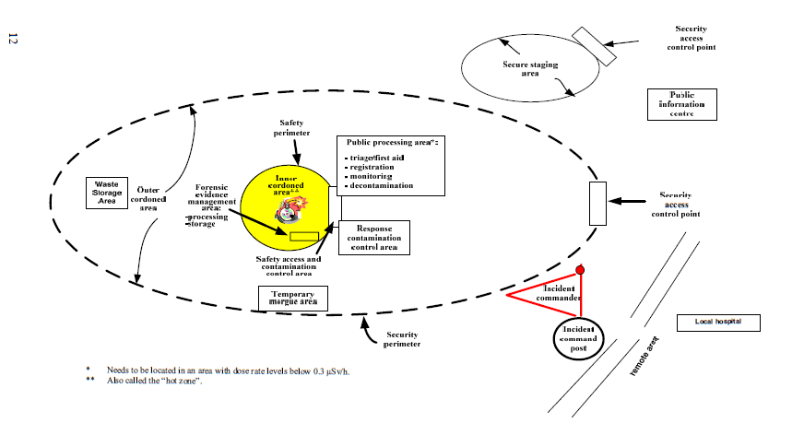
Intervention (II)
Areas established for first responders

Slide 22
Intervention (III)
Intervention actions
protection of emergency workers
alerting permanent, transient, and special population groups
urgent protective actions
shelter
evacuation
prophylactic medication
protection of water and food supplies
restrictions on farming, ranching, self-supply
traffic control: air, water, road, and rail

Slide 23
Emergency Plan
Allocation of responsibilities
Identification of the various operating and other conditions which could require intervention
Intervention levels, for the relevant protective actions
Procedures and lines of communication with response organizations (fire fighting, medical, police, regulatory authorities, etc.)
Description of methodology and instrumentation for assessing consequences
Description of public information arrangements
Criteria for terminating protective actions

Slide 24
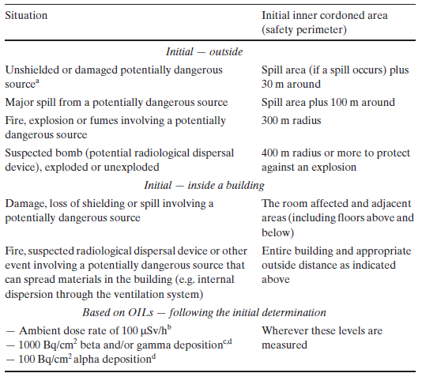
Emergency Plan (II)
Suggested radius for inner cordoned area

Slide 25
Logistics
Emergency conditions
items and facilities to be operational under the postulated conditions
tools, instruments
supplies
equipment
communication systems
facilities
documentation (procedures, check lists, telephone numbers, manuals)

Slide 26
Exercises
Identification of necessities
knowledge
skills
abilities
Requisition
personnel
equipment
Training, drills, exercises
refresher training
participation
performance evaluation

Slide 27
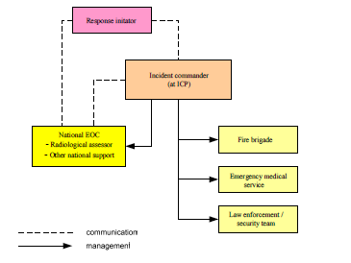
Operation
Initial response organization

Slide 28
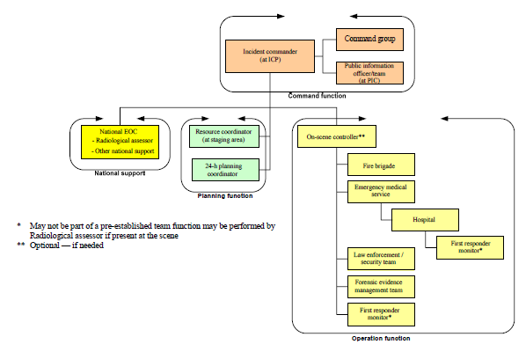
Operation (II)
Response organization

Slide 29
Operation (III)
Personnel
incident commander
incident command post
staff organization (S1 - S6, G1 - G6)
liaison officers
field personnel
emergency response organizations
authorities
media and public communication
experts and specialists

Slide 30
Operation (IV)
Personnel (cont.)
command staff
S1: personnel
S2: incident information (“intelligence”)
S3: operational planning
S4: logistics (supplies, transport, etc.)
S5: communication
S6: electronic infrastructure (phones, computers, networks, etc.)

