Slide 1
ERHS 561
Exposure of the Public to Ionizing Radiation
Alexander Brandl
Environmental and Radiological Health Sciences

Slide 2
Radiation Exposure
Any human population is exposed to a variety of radiation sources
ubiquitous background radiation, including Rn in homes
patient exposure from medical procedures
consumer products or activities involving radiation sources
industrial, security, medical, educational, and research radiation sources
occupational exposure of workers

Slide 3
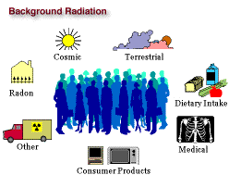
Radiation Exposure (II)
Schematic summary of exposure pathways for the general public

Slide 4
U.S. Radiation Exposure
Data extracted from NCRP 160 (2009)
using 2006 data
Definition of terms used by NCRP
average effective dose, E_{exp} [mSv]
to an individual in a group exposed to a specific source, excludes individuals not subject to exposure by that source
collective effective dose, S [person-Sv]
cumulative dose to a population of individuals exposed to a source
effective dose per individual (U.S.), E_{US} [mSv]
S / N (300 million), regardless of exposure

Slide 5
U.S. Rad. Exposure (II)
Overall results for 2006
estimate based on U.S. population of 300 million
S = 1,870,000 person-Sv
E_{US} = 6.2 mSv
98 % E_{US} due to ubiquitous background (50 %) and medical exposure of patients (48 %)
2 % consumer products and activities
0.1 % each: industrial, occupational

Slide 6
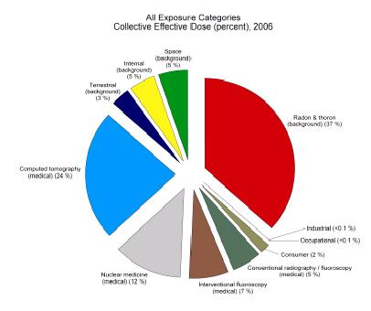
U.S. Rad. Exposure (III)
Exposure of the United States population to ionizing radiation (2006 data)
(from NCRP 160)

Slide 7
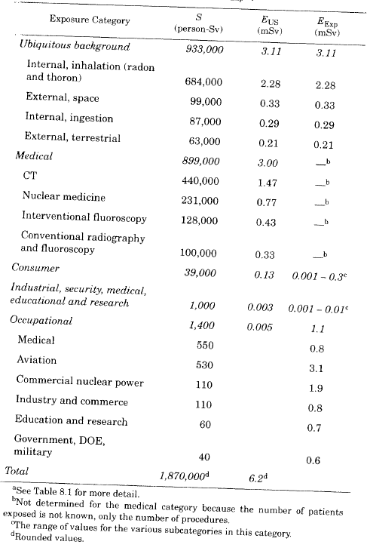
U.S. Rad. Exposure (IV)
Exposure of the United States population to ionizing radiation (2006 data)
(from NCRP 160)

Slide 8
U.S. Rad. Exposure (V)
Value for S increased
factor 2.2 from early 1980’s
increase in total population
230 million to 300 million (30 %)
Value for E_{US} increased
factor 1.7 from early 1980’s
primarily due to increased utilization of:
computed tomography (CT)
nuclear medicine
interventional fluoroscopy

Slide 9
U.S. Rad. Exposure (VI)
General observation concerning the results
two major contributors to exposure of the U.S. population
ubiquitous background radiation
medical exposure of patients
stochastic health risks
populations are not equal
ubiquitous background: entire U.S. population in age, gender, and health status
medical exposure of patients: population bias towards older and sicker individuals (gender?)
different radiation types

Slide 10
Natural Background
Effective dose per individual in the U.S. population
E_{US} = 3.1 ± 3.6 mSv y⁻¹ (arithmetic mean)
S or E_{US} for the U.S. population 50 %
internal, inhalation (Rn) (73 %)
external, space (11 %)
internal, ingestion (9 %)
external, terrestrial (7 %)
Population specifics
all members of the U.S. population
Exposure varies with
geographic location
diet
drinking water source
building construction

Slide 11
Natural Background (II)
Cosmogenic radionuclides
beta-, gamma, or X-ray emitters
produced by interactions of cosmic nucleons with atoms in the atmosphere or in the earth
³H, ⁷Be, ¹⁴C, ²²Na
Primordial radionuclides
mostly isotopes of heavy elements
extremely long half-lives
²³⁸U, ²³²Th, and ²³⁵U decay chains (²²²Rn, ²²⁰Rn)
⁴⁰K (∼ 1/3 external terrestrial and internal whole-body dose), ⁸⁷Rb
Radon
concentration varies diurnally, temporally, and geographically
Anthropogenic radionuclides
production and release of radioactive material to the environment
“licensed” use of radionuclides

Slide 12
Natural Background (III)
Radiation from space
solar energetic particles (solar events)
anomalous cosmic rays (interstellar space)
galactic cosmic rays
extragalactic cosmic rays
charged particles (mostly protons), generate high-energy secondary particles (muons, electrons, photons, some neutrons)
Terrestrial radiation
radionuclides in igneous and sedimentary rock
gamma radiation
⁴⁰K, ²³⁸U and ²³²Th decay chains
Radionuclides in the body
U and Th decay chains, ⁴⁰K, ⁸⁷Rb, ¹⁴C
ingestion of food, milk, water, or inhalation

Slide 13
Natural Background (IV)
“Occupational” exposure
extraction of rare earths from monazite
production of thorium compounds and manufacture of thorium-containing products
processing of Nb / Ta ore
oil and gas production
TiO₂ pigment production
thermal phosphorus production
zircon and zirconia industry
production of phosphate fertilizer
cement production, maintenance of clinker ovens
coal-fired power plants, maintenance of boilers
phosphoric acid production
primary iron production
tin / lead / copper smelting
ground water treatment

Slide 14
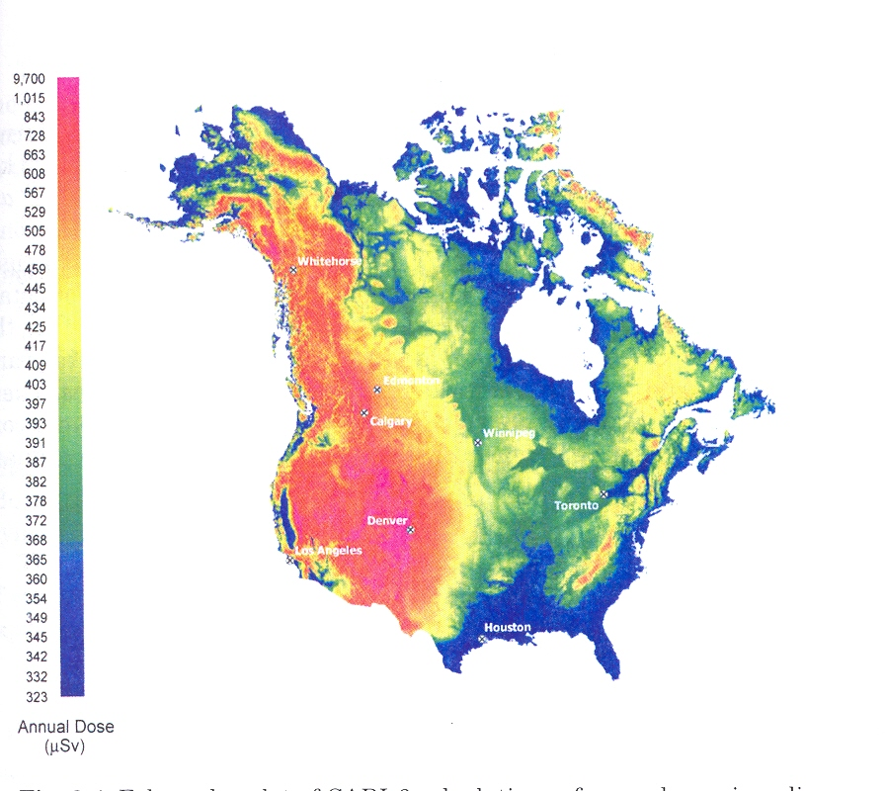
Natural Background (V)
Space radiation
average: indoor 0.318 mSv y⁻¹, outdoor 0.397 mSv y⁻¹
maximum: indoor 0.654 mSv y⁻¹, outdoor 0.818 mSv y⁻¹
(from NCRP 160)

Slide 15
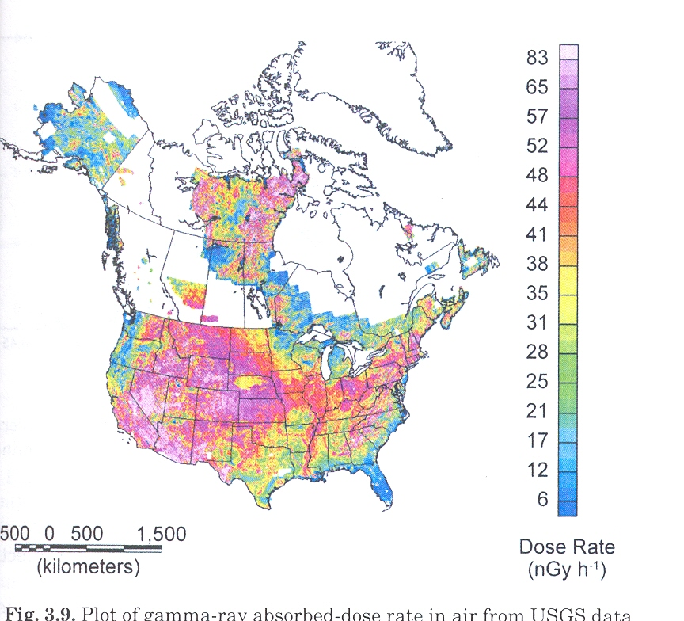
Natural Background (VI)
Terrestrial gamma radiation
gamma ray absorbed dose in the U.S. and Canada
(from NCRP 160)

Slide 16
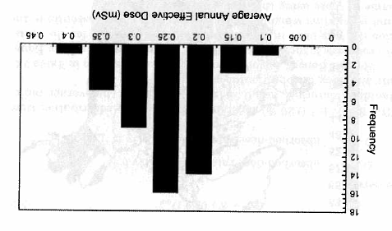
Natural Background (VII)
Terrestrial gamma radiation (cont.)
variability in average annual effective dose
(from NCRP 160)

Slide 17
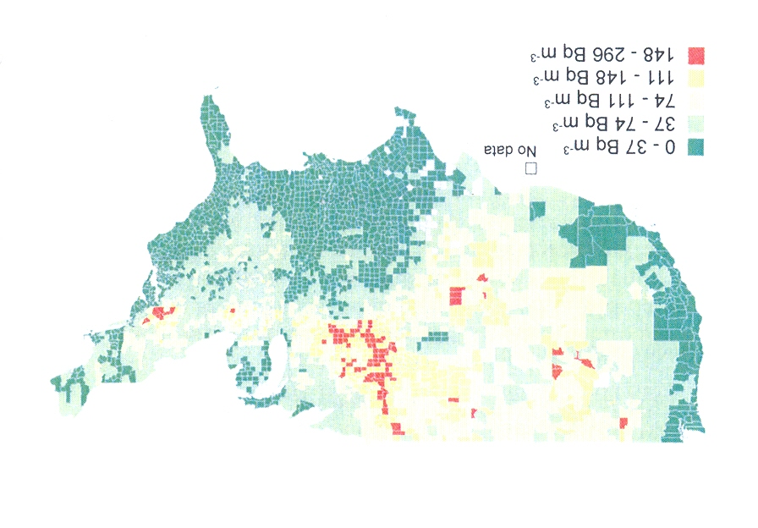
Natural Background (VIII)
Radon and short-lived decay products
predicted long-term average radon concentration in living areas in the U.S.
(from NCRP 160)

Slide 18
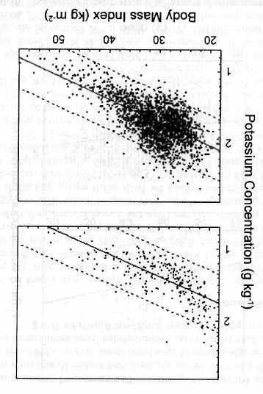
Natural Background (IX)
Radionuclides in the body
⁴⁰K concentration, decreases with age, BMI
(from NCRP 160)

Slide 19
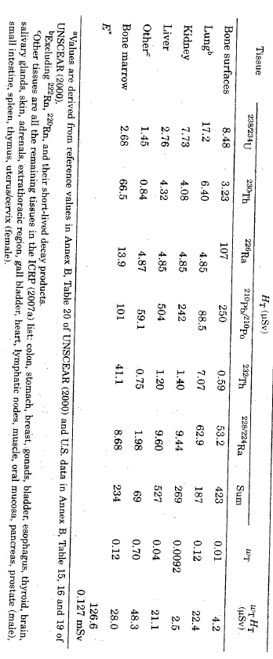
Natural Background (X)
Radionuclides in the body
U- and Th-decay series
(from NCRP 160)

Slide 20
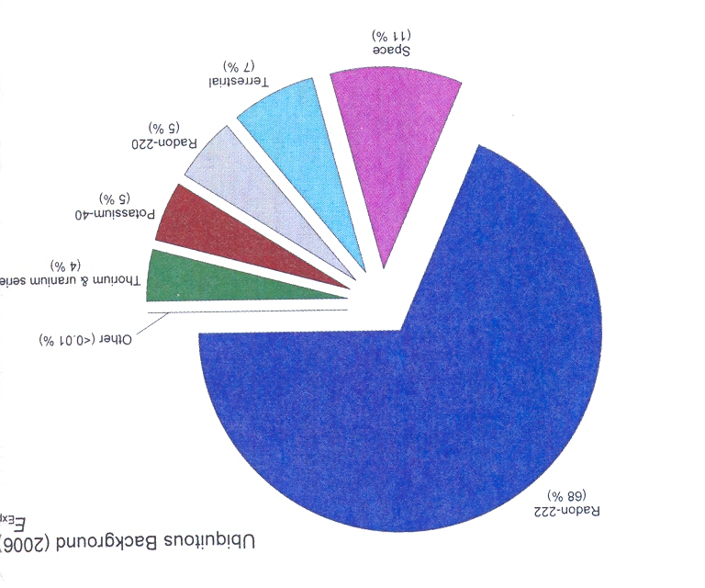
Natural Background (XI)
Summary
percentage contribution to ubiquitous background
(from NCRP 160)

Slide 21
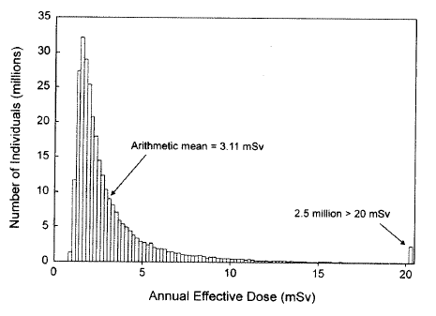
Natural Background ()
Summary (cont.)
annual effective dose from ubiquitous background
(from NCRP 160)

Slide 22
Medical Exposure
Medical exposure of patients
Data primarily have been assessed for:
X-ray sources used in CT, conventional radiography and fluoroscopy, interventional fluoroscopy, and radiation therapy
gamma sources in nuclear medicine and radiation therapy
Population specifics
generally older and sicker population
possibly skewed in gender distribution
Data used for assessment
number of medical procedures
effective dose per procedure

Slide 23
Medical Exposure (II)
Computed tomography (CT)
method for acquiring and reconstructing images of thin cross sections of an object
differences to conventional radiography
CT eliminates superimposition of structures due to 2-d projection of a 3-d object
CT sensitivity to subtle differences in X- ray attenuation higher by factor ∼ 10
increase in rate of use ∼ 8 – 15 % year⁻¹ over the last 7 – 10 years

Slide 24
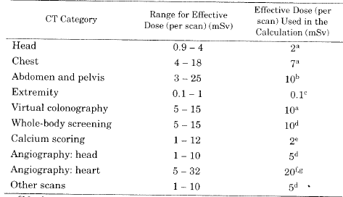
Medical Exposure (III)
CT (cont.)
E per scan
(from NCRP 160)

Slide 25
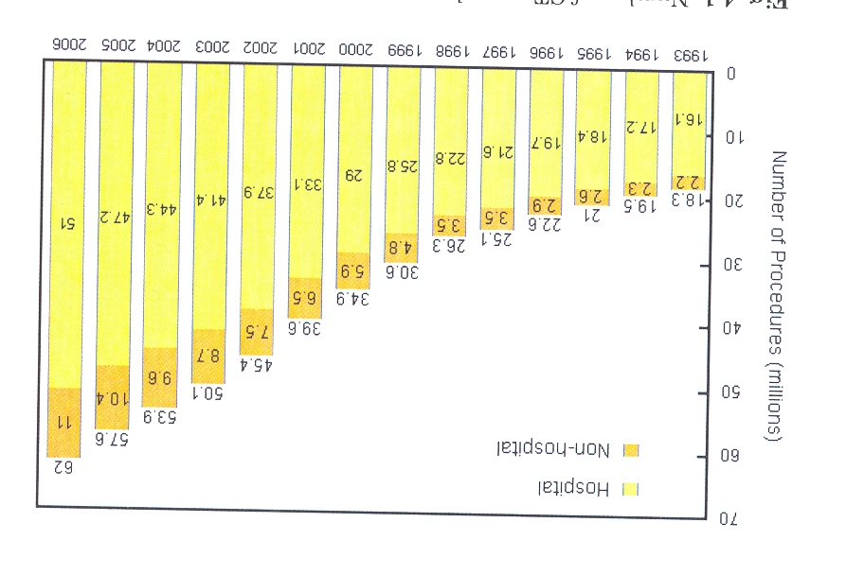
Medical Exposure (IV)
CT (cont.)
number of scans per year
(from NCRP 160)

Slide 26
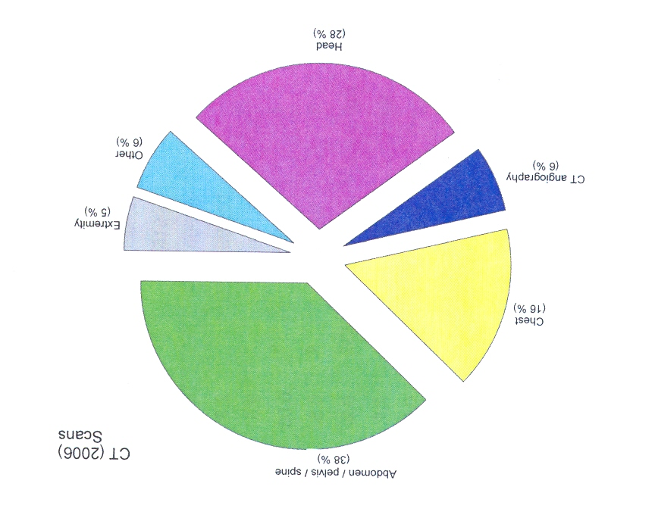
Medical Exposure (V)
CT (cont.)
number of scans per year
(from NCRP 160)

Slide 27
Medical Exposure (VI)
Conventional radiography and fluoroscopy
largest number of X-ray examinations
however, now only relatively small portion of medical dose
conventional radiography
systems using screen-film image receptors, computed radiography, digital radiography, direct exposure film, any other 2-d projection system
conventional fluoroscopy
real-time projection imaging for diagnostic purposes

Slide 28
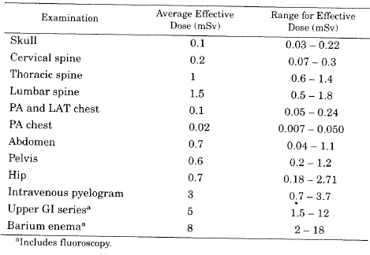
Medical Exposure (VII)
Conventional radiography (cont.)
E per examination
(from NCRP 160)

Slide 29
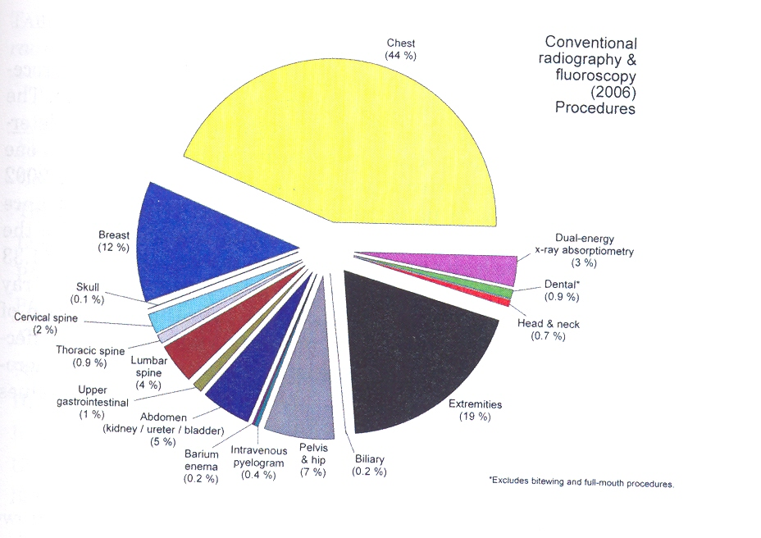
Medical Exposure (VIII)
Conventional radiography (cont.)
number of procedures per year
(from NCRP 160)

Slide 30
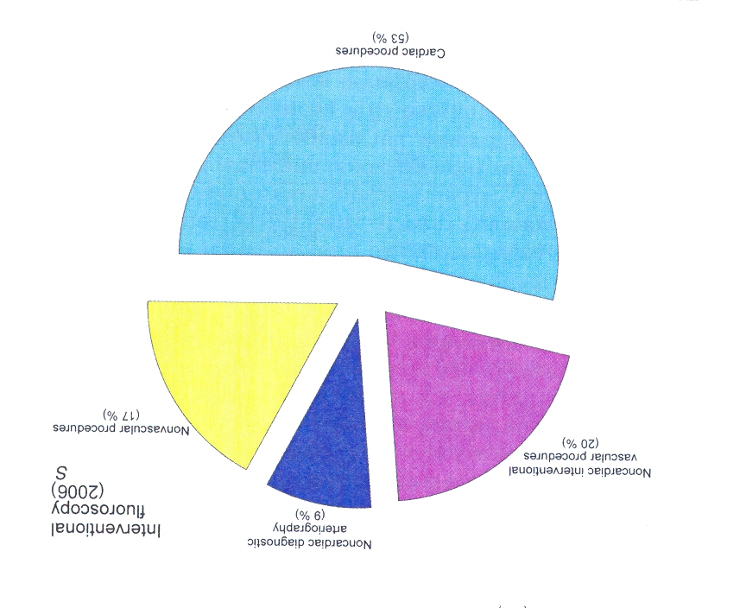
Medical Exposure (IX)
Interventional fluoroscopy
any procedure with fluoroscopically guided medical device
diagnostic and therapeutic
collective effective dose, S
(from NCRP 160)

Slide 31
Medical Exposure (X)
Nuclear medicine
unsealed radionuclides used for diagnostics or therapy
display physiologic and metabolic mechanisms
regional blood flow
regional pulmonary ventilation
organ function
cellular metabolism
other in vivo biologic processes
radiopharmaceuticals
administered orally, inhalation, or injection
localize in target tissues or organs

Slide 32
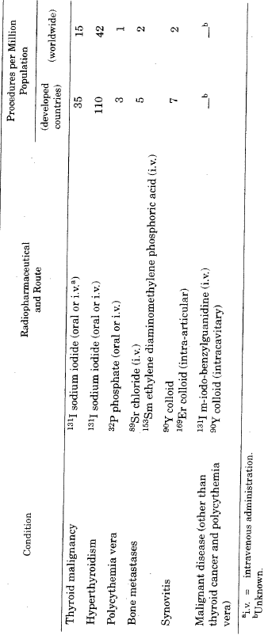
Medical Exposure (XI)
Nuclear medicine (cont.)
number of procedures per year (worldwide)
(from NCRP 160)

Slide 33
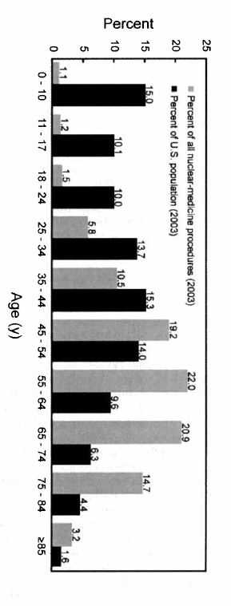
Medical Exposure (XII)
Nuclear medicine (cont.)
age distribution for patients
(from NCRP 160)

Slide 34
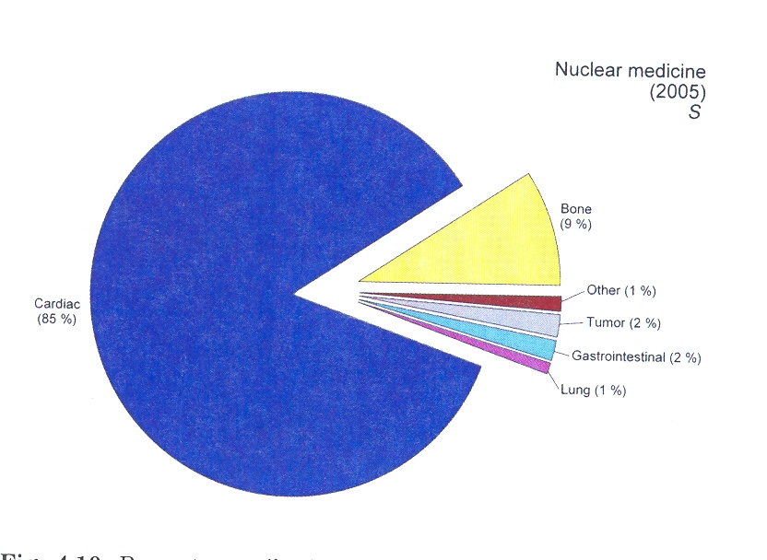
Medical Exposure (XIII)
Nuclear medicine (cont.)
collective effective dose, S
(from NCRP 160)

Slide 35
Medical Exposure (XIV)
Radiotherapy (external beam)
extremely high treatment doses
deterministic, rather than stochastic effects
tissue doses vary widely
depending on patient’s disease and condition
neutron spallation for beam energies > 10 MeV

Slide 36
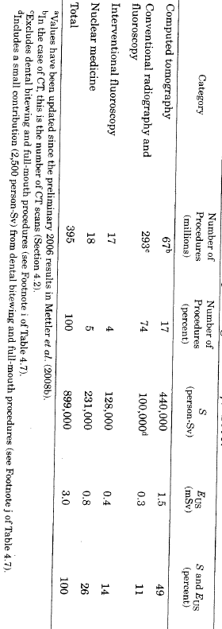
Medical Exposure (XV)
Summary
total S and E_{US}
(from NCRP 160)

Slide 37
Consumer Products
Relatively large number of individuals, exposed to low doses
E_{US} = 0.1 mSv y⁻¹
Variation in E_{Exp} : 0.001 – 0.3 mSv y⁻¹
Products and activities considered
cigarette smoking (35 %)
building materials (27 %)
commercial air travel (26 %)
mining and agriculture (6 %)
other sources (3 %)
combustion of fossil fuels (2 %)
highway and road construction materials (0.6 %)
glass and ceramics (< 0.03 %)
television, video, sewage sludge and ash, signs

Slide 38
Consumer Products (II)
Commercial air travel
Travel statistics:
660.7 million passengers domestic (89 %)
84.8 million passengers international (11 %)
Average dose rates and doses
depend on flight altitudes, latitudes, and flight time
domestic flights: $\dot{E}=3.30±1.81 μSv h^{−1}$
international flights: $\dot{E}=5.21±0.94 μSv h^{−1}$
flight time domestic 2.84 h, $E=9.37±5.14 μSv$
flight time international 9.35 h, $E=48.7±8.79 μSv$

Slide 39
Consumer Products (III)
Tobacco products
Smoking statistics
45 million smokers (21 %)
36 million smoke daily
8.3 million smoke some days
5.4 million heavy smokers (> 25 d⁻¹)
mean number per day: 17 (18 men, 15 women)
radionuclides: mainly ²¹⁰Pb and ²¹⁰Po
inhalation: ∼ 14 mBq per cigarette
E_{(cigarette per day)} = 0.018 mSv y⁻¹
E_{(one pack a day)} = 0.36 mSv y⁻¹ (0.1 – 0.7 mSv y⁻¹)

Slide 40
Consumer Products (IV)
Glass and ceramics
Containing compounds of uranium (uranium dioxide, sodium diuranate)
Color in glassware, glaze for ceramics
NRC exemption for glassware 10 % U by weight
beta and gamma exposure from handling
ingestion after leaching from glass
person routinely handling glassware: ∼ 20 μSv y⁻¹
NRC exemption for glazed ceramics 20 % U by weight
beta and gamma exposure from handling (dose rate 0.04 – 3.2 μSv h⁻¹)
ingestion of leached U: up to 400 μSv y⁻¹
display: dose rate at 1 m 0.004 - 0.32 μSv y⁻¹

Slide 41
Consumer Products (V)
Building materials
Materials used in bulk and superficial or restricted use
coal combustion products (fly ash, bottom ash)
concentration of ²²⁶Ra in fly ash O(100 Bq kg⁻¹)
Minor exposures due to
zircon-glazed tiles and fixtures (tubs, toilets, and sinks)
granite countertops, desktops, floor and wall tile
marble housing construction material

Slide 42
Consumer Products (VI)
Building materials (cont.)
Proposal by the European Commission
activity concentration index, I
$$I=\frac{c_{Ra−226}}{300 \text{Bq} {\text{kg}}^{\text{−1}}}+\frac{c_{Th−232}}{200 \text{Bq} {\text{kg}}^{\text{−1}}}+\frac{c_{K−40}}{3000 \text{Bq} {\text{kg}}^{\text{−1}}}$$
proposed reference level for indoor external exposure 1 mSv y⁻¹
highly controversial
 | Category (corresponding default dose)
Use | A (≤ 1 mSv) | B (> 1 mSv)
(1) materials used in bulk amounts | A1 I≤1 | B1 I>1
(2) superficial and other materials with restricted use. | A2 I≤6 | B2 I>6

Slide 43
Consumer Products (VII)
Building materials (cont.)
Austrian Decree on Naturally Occurring Radioactive Sources
criterion for building materials
$$\frac{c_{Ra−226}−40}{40}+\frac{c_{Th−232}−25}{240}+\frac{c_{K−40}−370}{4000}≤1$$
indoor exposure (including external exposure and Rn-inhalation) < 1 mSv above background y⁻¹
if compliance cannot be established using intrinsic assumptions on usage (bulk material), use material specifics (thickness, density, mass per unit area Rn emanation properties)

Slide 44
Industrial and Other
Industrial, security, medical, educational, and research activities
< 0.1 % total S or E_{US}
nuclear medicine patients (72 %)
nuclear power generation (15 %)
industrial, medical, educational, and research activities (13 %)
DOE installations (<< 1 %)
decommissioning and radioactive waste (<< 1 %)
security inspection systems (<< 1 %)
E_{Exp}= 1 – 10 μSv y⁻¹
Exposure: members of the public in close proximity to activity

Slide 45
Industrial and Other (II)
Consideration of the public only, here
no worker exposure
Intentional use of ionizing radiation or production of sources or as byproducts
nuclear fuel cycle
manufacture and use of radioactive sources
irradiators for sterilization, radiography, and materials processing
DOE facilities
radioactive waste transport and disposal
security inspection
nuclear medicine and radiology

Slide 46
Industrial and Other (III)
Nuclear fuel cycle
uranium mining and milling
uranium hexafluoride production
²³⁵U enrichment
fuel fabrication
power production
fuel reprocessing
low- and high-level radioactive waste management
Population in consideration: < 80 km from site
Various exposure pathways (external, internal)

Slide 47
Industrial and Other (IV)
Nuclear fuel cycle (cont.)
conservative dose estimates
≤ 2.6 mSv y⁻¹ for milling, but much smaller values apply to some mills
≤ 0.6 mSv y⁻¹ due to uranium mining
≤ 0.2 mSv y⁻¹ for transport (maximum compliance levels assumed, exposure generally much lower)
≤ 0.25 mSv y⁻¹ for plant operation (due to release / discharge limits)
accidents (Three Mile Island)
average dose 0.8 mSv (< 16 km)
average dose 15 μSv (< 80 km)

Slide 48
Industrial and Other (V)
DOE facilities
conservative dose estimates
Maximally Exposed Individual, MEI
population living < 80 km
resulting in upper bound estimates
all DOE sites: < 0.001 – 0.6 μSv y⁻¹
almost all < 0.05 μSv y⁻¹
Decommissioning and radioactive waste
regulated activities
≤ 0.25 mSv y⁻¹ for operation (due to release / discharge limits)

Slide 49
Industrial and Other (VI)
Security inspection systems
cabinet X-ray systems for luggage
exposure limits at enclosure
cargo scanners
inadvertently exposed individual ≤ 5 mSv
individuals inside facility ≤ 0.5 μSv h⁻¹
individuals outside facility ≤ 0.25 mSv y⁻¹
Personnel security systems (NCRP recommendations)
general-use systems: < 0.1 μSv per scan (backscatter typically ∼ 0.03 μSv per scan)
limited-use systems: ≤ 10 μSv per scan (transmission X-ray typically 0.5 to 6 μSv per scan)

Slide 50
Occupational Exposure
< 0.1 % total S or E_{US}
medical (39 %)
aviation (38 %)
commercial nuclear power (8 %)
industry and commerce (8 %)
education and research (4 %)
government, DOE, and military (3 %)
E_{Exp}= 0.6 – 3.1 mSv y⁻¹ (average 1.1 mSv y⁻¹)
Exposure: all adults

Slide 51
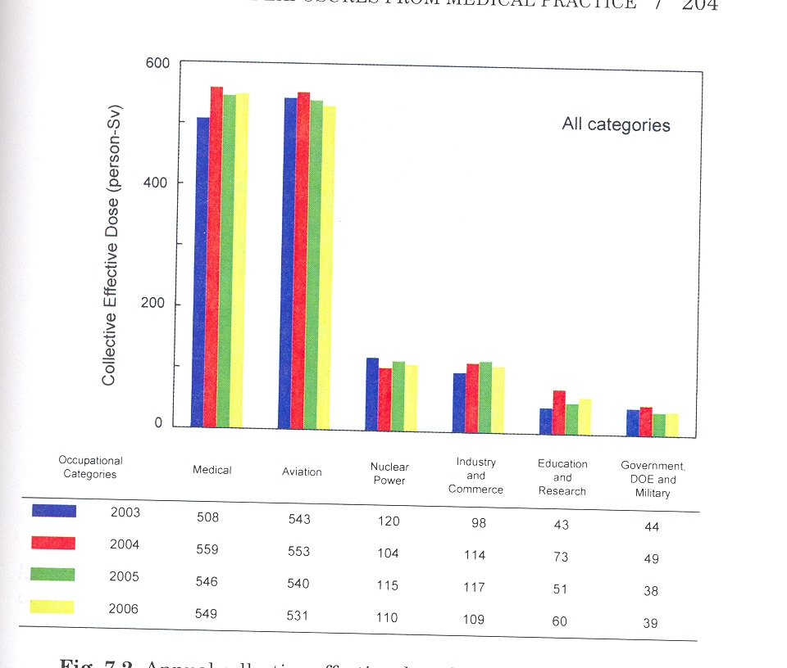
Occupational Exposure (II)
Average annual effective dose for workers, E_{Exp}
(from NCRP 160)

Slide 52
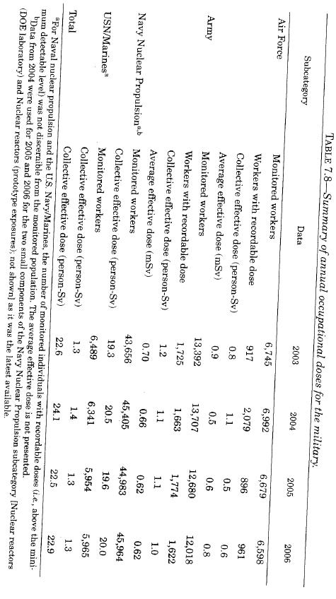
Occupational Exposure (III)
Dose for military personnel, S and E_{Exp}
(from NCRP 160)

Slide 53
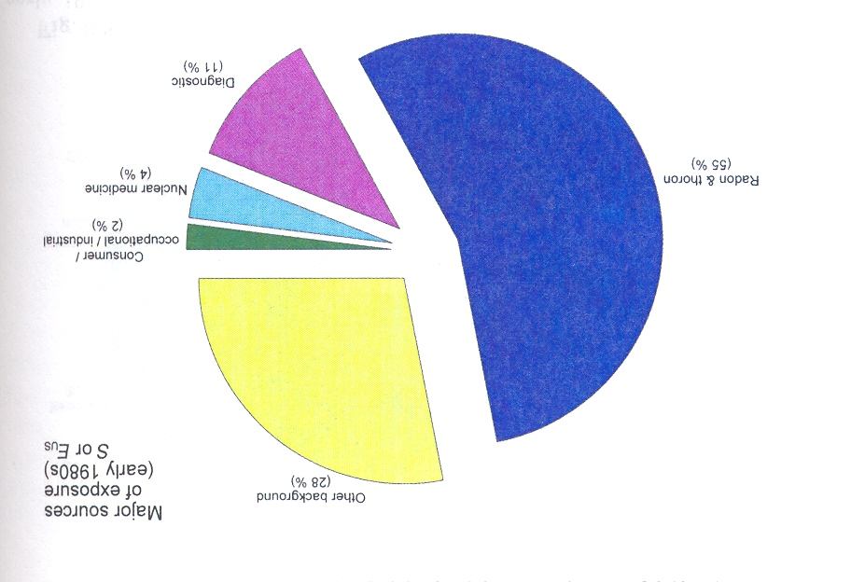
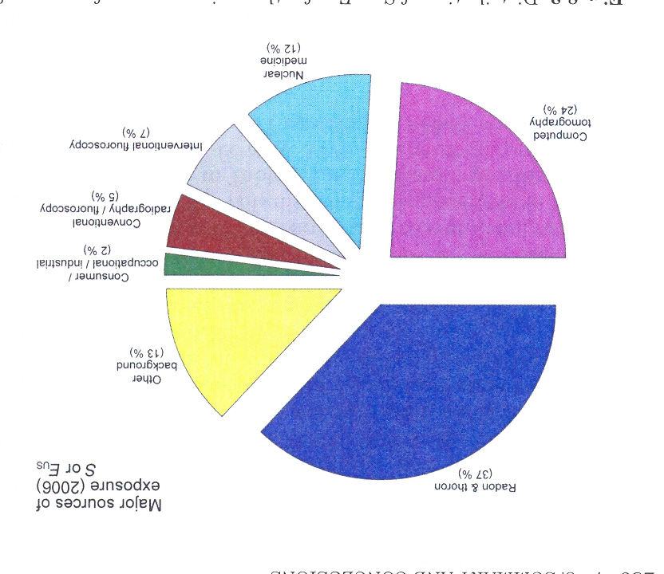
Summary
Exposure trends (early 1980’s to 2006)
E_{US}: increase from 3.6 to 6.1 mSv y⁻¹
E _{US, medical}: increase from 0.53 to 3 mSv y⁻¹
(from NCRP 160)

